Slide 1

Accidents in the Kingdom of Saudi Arabia
By:
Ziad Othman Al-Abduljabbar
441100931
Mohammed Ahmed Alghanam
441101802

Slide 2

INTRODUCTION:
In this presentation, we will explore the study of traffic accidents that occurred in the Kingdom of Saudi Arabia from 2016 to 2019. The analysis is based on the dataset titled "Saudi Arabia Traffic Accidents and Casualties (Injured and Dead).

Slide 3
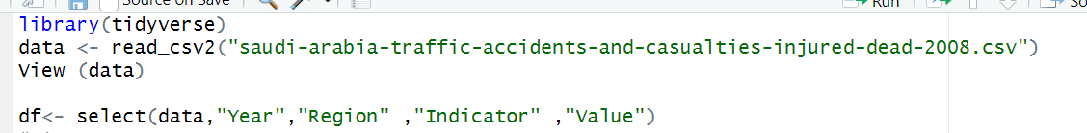
First step
Loading the required libraries and data set and select the required columns

Slide 4
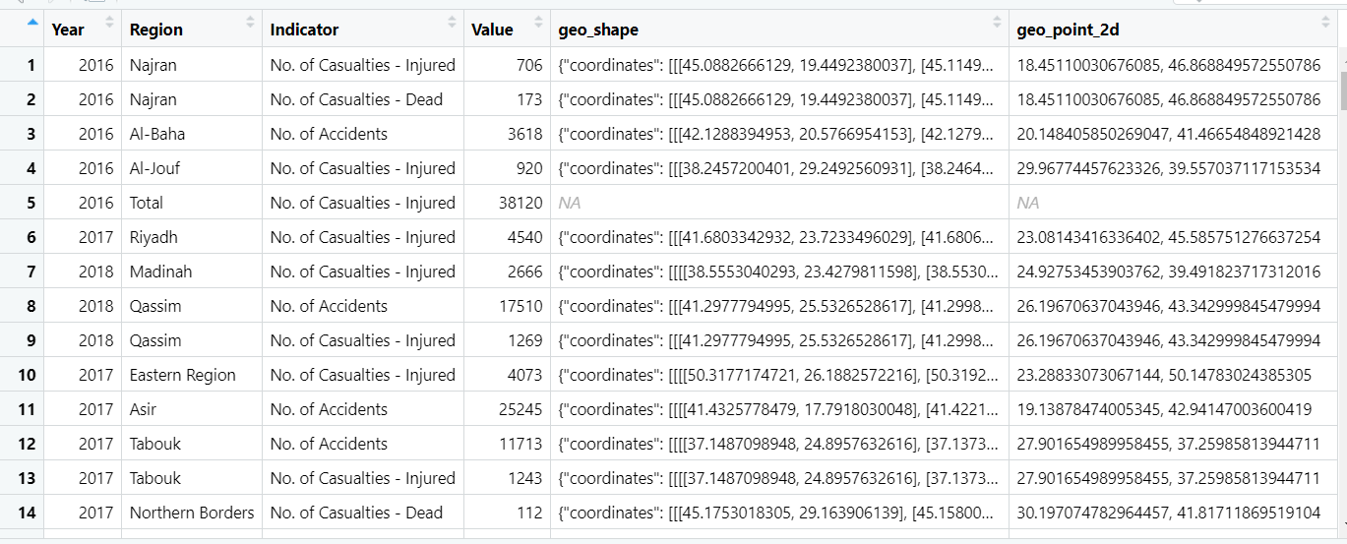
Dataset:

Slide 5
Number of Accidents by region
Comparison of Accidents ,Deaths and Injuries by Year
Cases that we will review and study
The relationship between injury and death across all regions
Number of Deaths by Region (2016–2019)

Slide 6
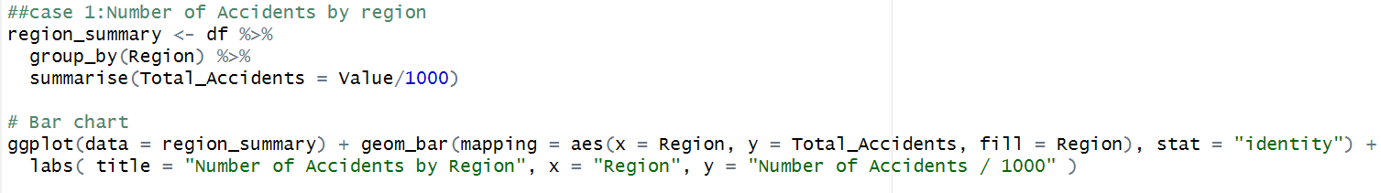
Case 1: Number of Accidents by region
Codes:
1
2

Slide 7
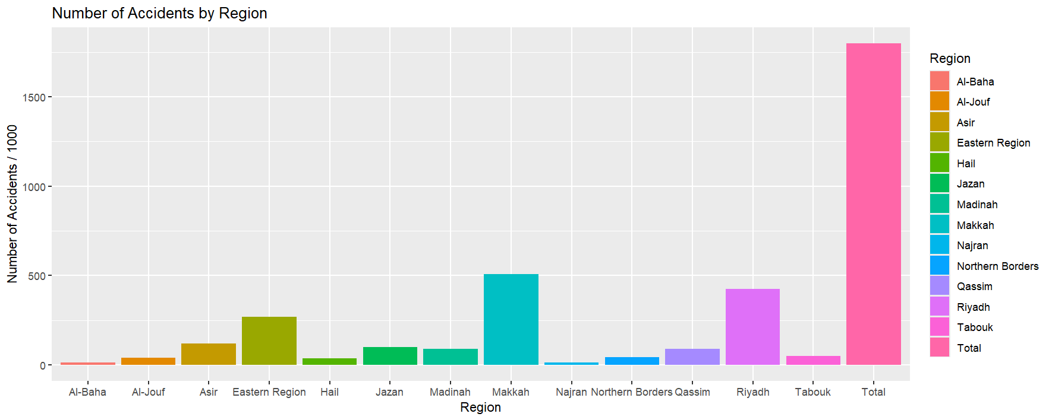
Output: 1

Slide 8
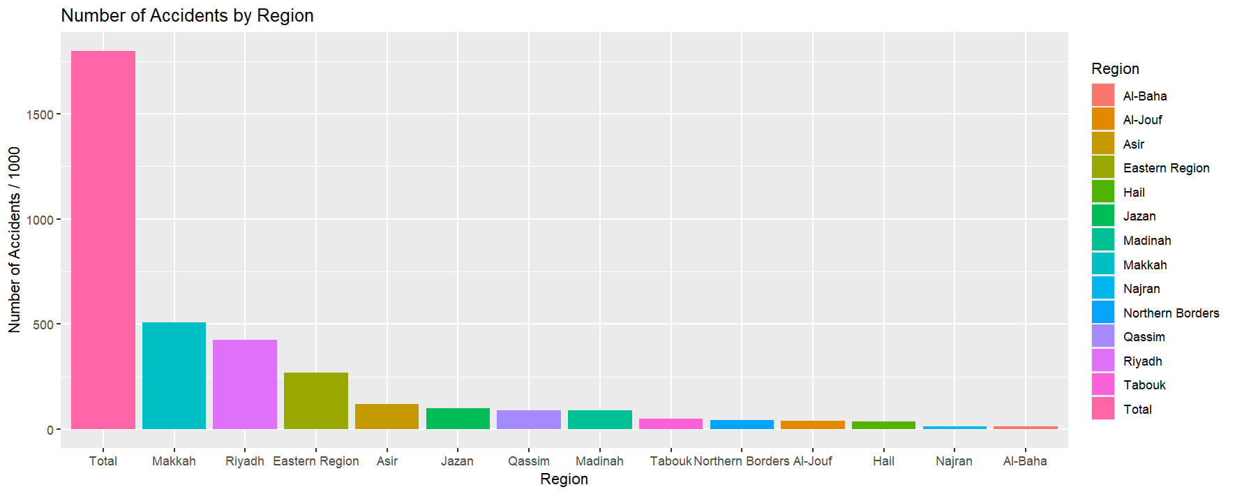
Output: 2

Slide 9
Understand:
The chart shows that Makkah had the highest number of accidents throughout the entire period (2016–2019), while Al-Baha recorded the lowest.
The ranking of regions from highest to lowest in terms of accidents is as follows:
{ Makkah > Riyadh > Eastern Region > Asir > Jazan > Qassim > Madinah > Tabouk > Northern Borders > Al-Jouf > Hail > Najran >
Al-Baha }

Slide 10
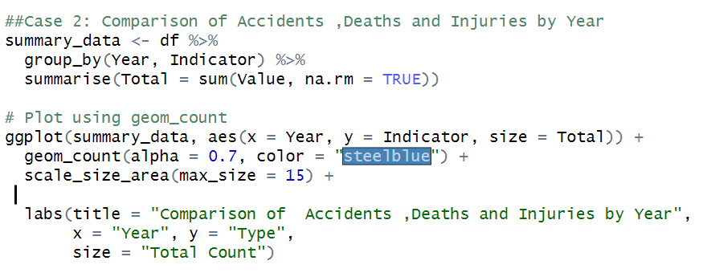
Case 2: Comparison of Accidents ,Deaths and Injuries by Year

Slide 11
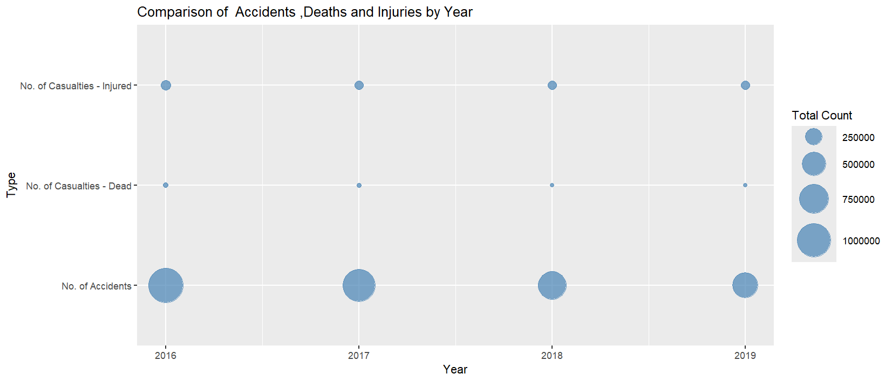
Output:

Slide 12
Understand
The chart shows that most accidents had no injuries or deaths in all the years.
It also shows that 2016 had the highest number of accidents compared to the other years.

Slide 13
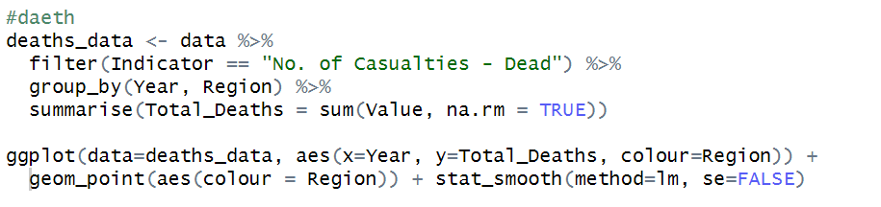
Case 3: Number of Deaths by Region (2016–2019)
Code:

Slide 14
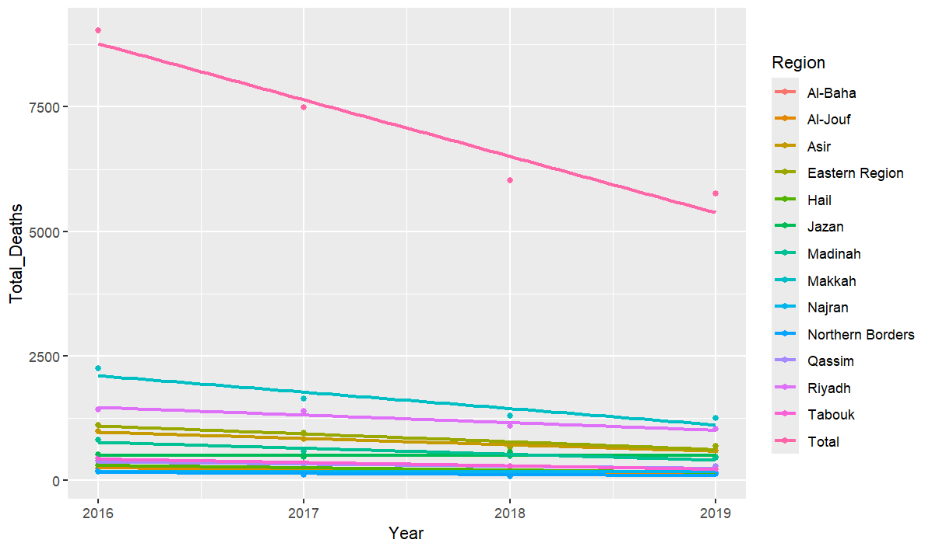
Output:

Slide 15
Understand
The regression line in the chart shows that the number of deaths is decreasing in all regions. 2016 had the highest number of accidents, while 2019 had the lowest across all regions.
This may also mean that people in Saudi Arabia are driving better in the last few years. This could be one reason why accidents are going down.

Slide 16
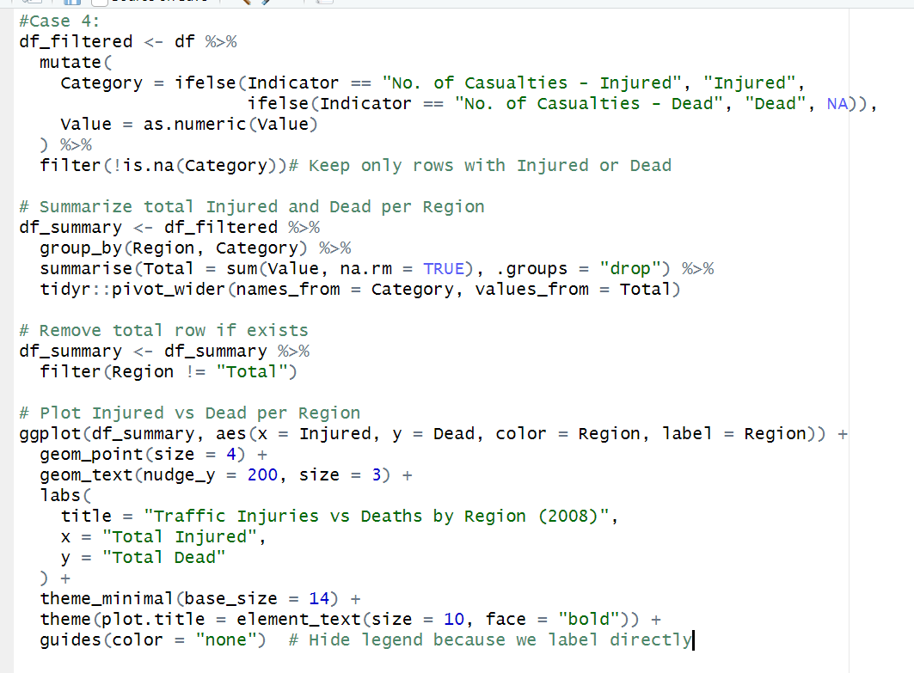

Case 4: The relationship between injury and death across all regions
Code:

Slide 17
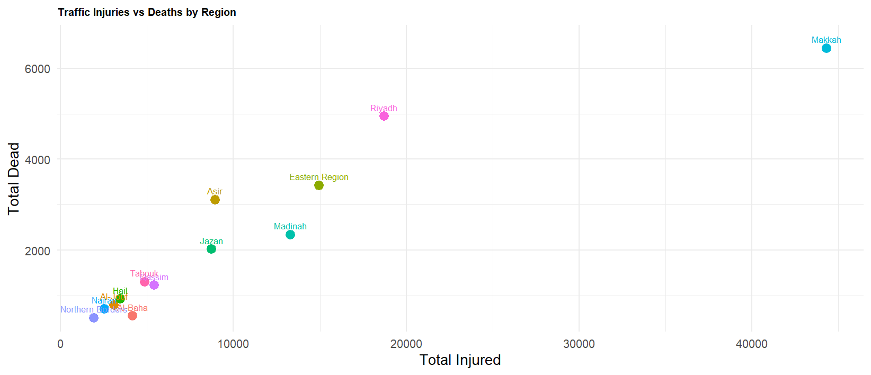
Output:

Slide 18
Understand
You can see how the number of injuries correlates with deaths in each region/year — high injuries often, but not always, mean more deaths.
Clustering of points reveals which regions behave similarly in accident severity.
Outliers help identify regions where accident patterns are unusual or where data quality may need review.

Slide 19
Conclusion
In summary, traffic accidents in Saudi Arabia have shown a notable decline in both frequency and severity from 2016 to 2019. The data indicates that while 2016 recorded the highest number of accidents and fatalities, there has been a consistent improvement each year, with 2019 reflecting the lowest numbers across all regions. This positive trend suggests increased public awareness, better driving behavior, and possibly more effective enforcement of traffic laws. Continued efforts in road safety education, infrastructure improvements, and law enforcement are essential to maintain and accelerate this progress.

Slide 20
Thank You
For Listening

